Slide 1

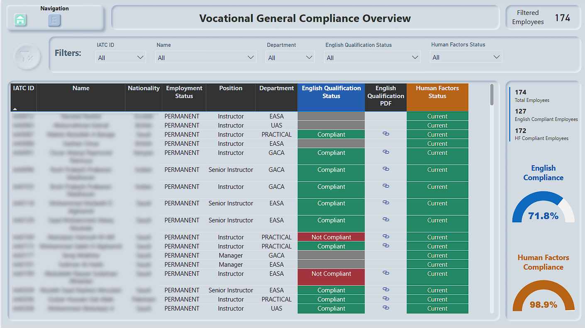
Employee Compliance - Overview Page
Shows a holistic look at overall employee Compliance for English and Human Factors requirements.

Slide 2
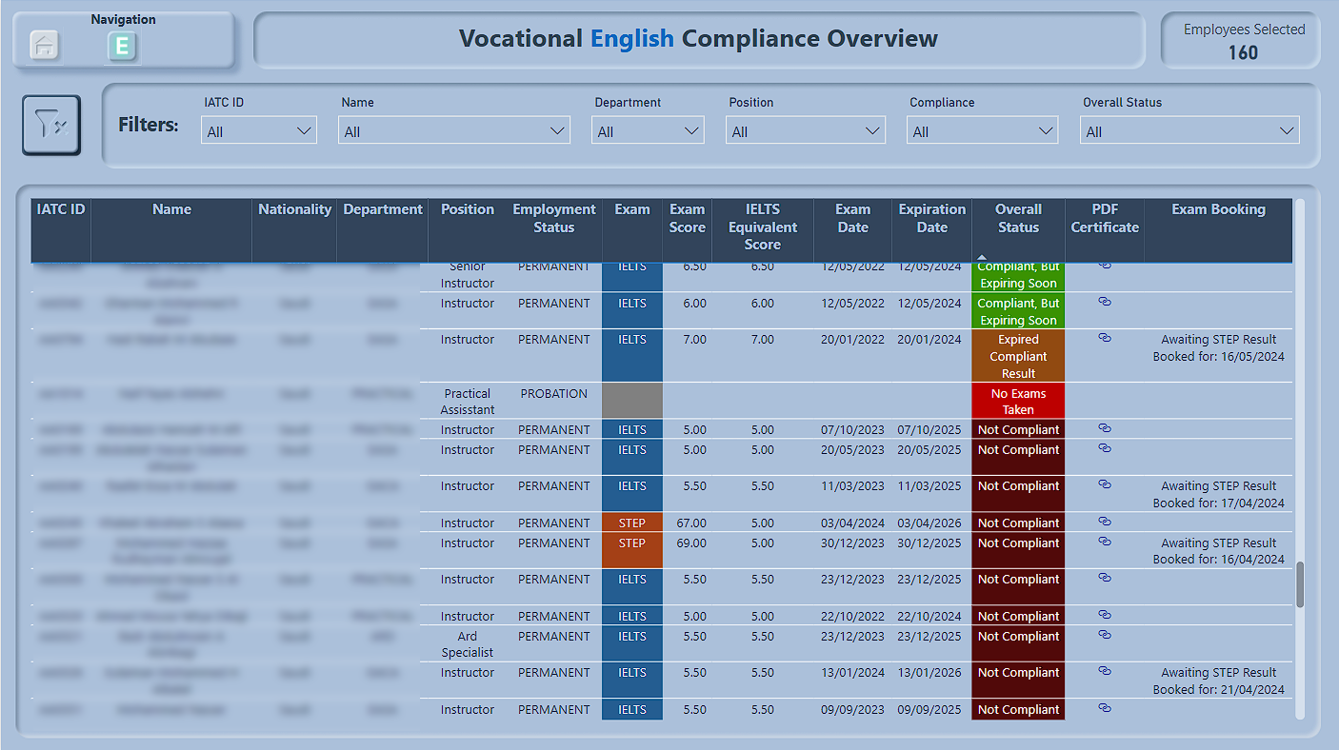
Employee Compliance - Gradebook Page
Shows a more detailed look at English compliance, including results, dates of exams and links to certificate PDFS

